Slide 1
Linked List I Session 03
Course : Data Structures
Effective Period : December 2018

Slide 2
Learning Outcomes
At the end of this session, students will be able to:
LO 1: Explain the concept of data structures and its usage in Computer Science
LO 2: Illustrate any learned data structure and its usage in application
LO 3: Apply data structures using C

Slide 3
Outline
Linked List Introduction
Linked List vs Array
Single Linked List
Polynomial Representation

Slide 4
Linked List Introduction
Linked list is a data structure that consists of a sequence of data records such that each record there is a field that contains a reference to the next record in the sequence.
Linked list allows insertion and deletion of any element at any location.
Linked list is used in many algorithms for solving real-time problems, when the number of elements to be stored is unpredictable and also during sequential access of elements.
A linked list consists of two types:
Single Linked List
Double Linked List

Slide 5
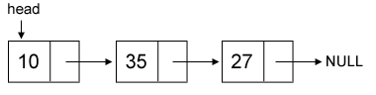
Linked List Introduction
Take a look at the following figure:
Example of a list whose nodes contain two fields:
an integer value and a link to the next node.
Linked list which node contain only a single link to other node is called single linked list.

Slide 6
Linked List versus Array
Array:
Linear collection of data elements
Store value in consecutive memory locations
Can be random in accessing of data
Linked List:
Linear collection of nodes
Doesn’t store its nodes in consecutive memory locations
Can be accessed only in a sequential manner

Slide 7
Memory Allocation: Dynamic
If you need to allocate memory dynamically (in runtime), you can use malloc in C/C++.
To de-allocate you can use free.
int *px = (int *) malloc(sizeof(int));
char *pc = (char *) malloc(sizeof(char));
*px = 205;
*pc = ‘A’;
printf( “%d %c\n”, *px, *pc );
free(px);
free(pc);

Slide 8
Single Linked List
To create a linked list, we first need to define a node structure for the list.
Supposed we want to create a list of integers.
struct tnode {
int value;
struct tnode *next;
};
struct tnode *head = 0;
head is the pointer to the
first element in our linked list.

Slide 9
Single Linked List
To create a list, we first need to define a node structure for the list.
Supposed we want to create a list of integers.
struct tnode {
int value;
struct tnode *next;
};
struct tnode *head = 0;
head is the pointer to the
first element in our linked list.

Slide 10
Single Linked List: Insert
To insert a new value, first we should dynamically allocate a new node and assign the value to it and then connect it with the existing linked list.
Supposed we want to append the new node in front of the head.
struct tnode *node =
(struct tnode*) malloc(sizeof(struct tnode));
node->value = x;
node->next = head;
head = node;
Operator -> has the same meaning as:
(*node).value = x;
(*node).next = head;

Slide 11
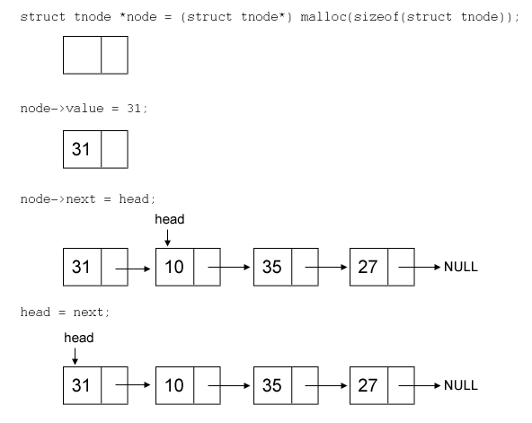
Single Linked List: Insert
Append a new node in front of head.
Assuming there is already a linked list
containing 10, 35, 27.

Slide 12
Single Linked List: Insert
How about the algorithm of inserting new node in the middle and in the last of the single linked list?
Can you try it by yourself?
You should try!

Slide 13
Single Linked List: Delete
To delete a value, first we should find the location of node which store the value we want to delete, remove it, and connect the remaining linked list.
Supposed the value we want to remove is x and assuming x is exist in linked list and it is unique.
There are two conditions we should pay attention to:
if x is in a head node or
if x is not in a head node.

Slide 14
Single Linked List: Delete
struct tnode *curr = head;
// if x is in head node
if ( head->value == x ) {
head = head->next;
free(curr);
}
// if x is not in head node, find the location
else {
while ( curr->next->value != x ) curr = curr->next;
struct tnode *del = curr->next;
curr->next = del->next;
free(del);
}

Slide 15
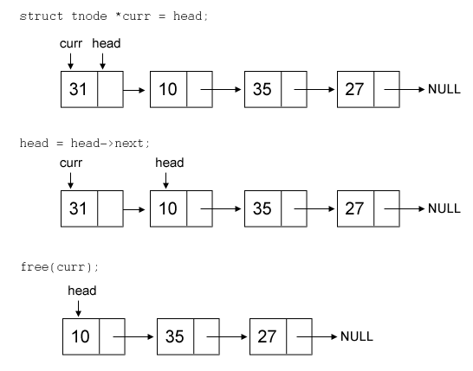
Single Linked List: Delete
Deleting 31 (located at head)

Slide 16
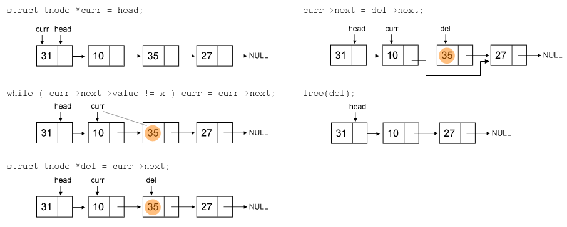
Single Linked List: Delete
Deleting 35 (not located at head)

Slide 17
Polynomial Representation
Polynomial is given as 6x³ + 9x² + 1
Every individual term in a polynomial consists of two parts, a coefficient and a power
Here, 6, 9, 7, and 1 are the coefficients of the terms that have 3, 2, 1, and 0 as their power respectively.
Every term of a polynomial can be represented as a node of the linked list.
6
3
9
2
7
1
1
0
x

Slide 18
Summary
Linked list is useful, especially in solving real-time problems where the number of elements to be stored is unpredictable and also during sequential access of elements.
Linked List has two types, single and double linked list.
Single linked list is characterized by having a single one way link from a list pointing to another list

Slide 19
References
S. Sridhar. 2015. Design and Analysis of Algorithms. Oxford University Press. New Delhi. ISBN: 9780198093695. Chapter 5
Reema Thareja. 2014. Data structures using C. Oxford University Press. New Delhi. ISBN:9780198099307. Chapter 6
Thomas H. Cormen, Charles E. Leiserson, Ronald L. Rivest, & Clifford Stein. (2009). Introduction to Algorithms. 03. The MIT Press. London. ISBN: 9780262033848. Chapter 10
Linked List, https://visualgo.net/en/list?slide=3

